Slide 1

TURN UP THE DATA
Anna Chee, Daniel Atuesta, Dan Waehner, Domenic Padulo, Nabila

Slide 2

BACKGROUND/MOTIVATION
Project Goal
Questions Asked
Dataset
Notes:
Project Goal: To look at how music trends have changed over time and how the variables tracked in the trends effect the popularity of the song.
Questions asked: started off looking to see how covid-19 effected the music industry
Dataset : looked at several apis and csvs with regards to music streaming services

Slide 3
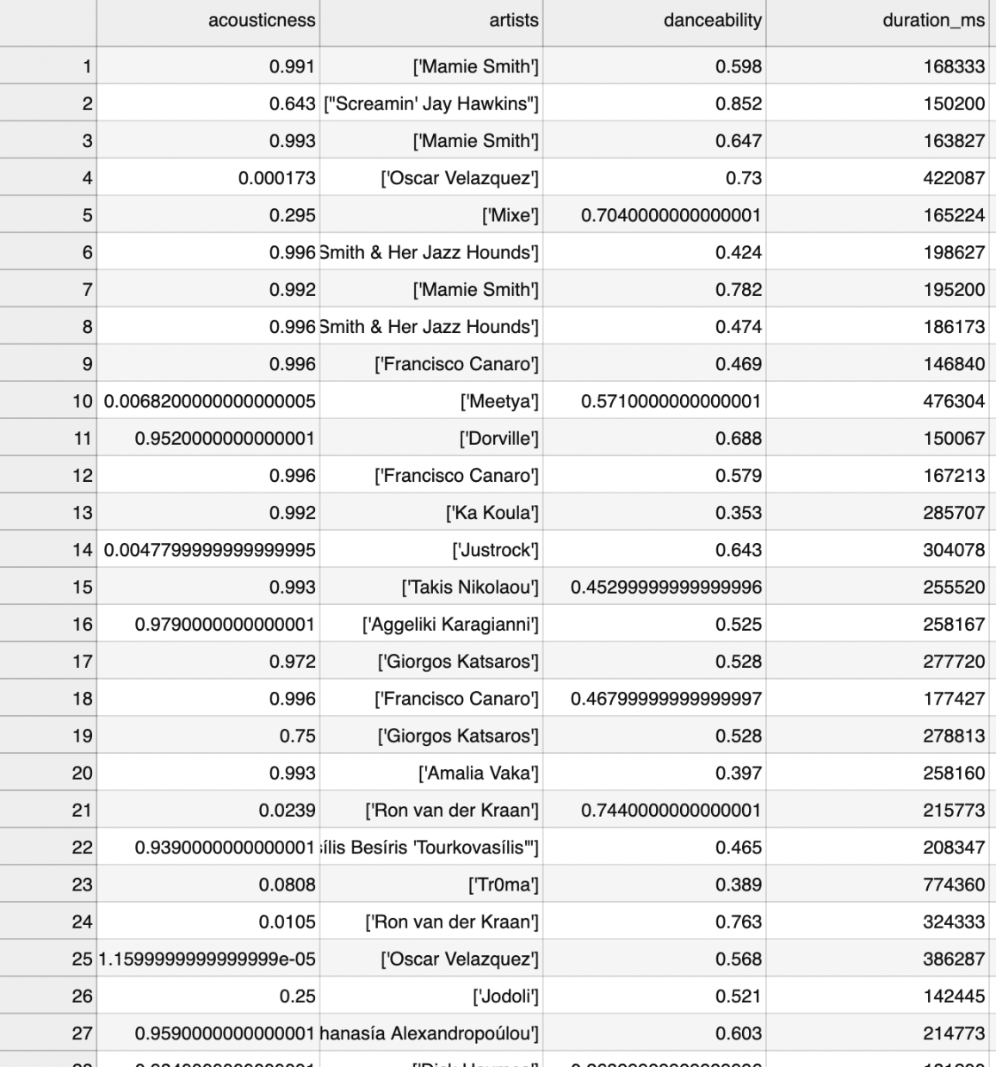
DATASET BACKGROUND
Dataset Considerations:
Large dataset with tracks from previous years
Music attributes
Popularity metric
Category by genre/artist
Dataset Source:
Spotify Dataset by Yamac Eren Ay
160k+ tracks from 1921-Jan. 2021
CSV files with numerical and categorical data
Notes:
Based on questions we wanted to investigate, had to consider ….
Dataset:
Created by Yamac Eren Ay (pulled from Spotify Web API)
More than 175,000 songs with tracks from 1921 - 2021
Numerical:
accousticness, danceability, energy, duration, instrumentalness, valence, popularity, tempo, liveness, loudness, speechiness, and year
Categorical:
Mode, explicitness, key, artist, song name, and release date

Slide 4
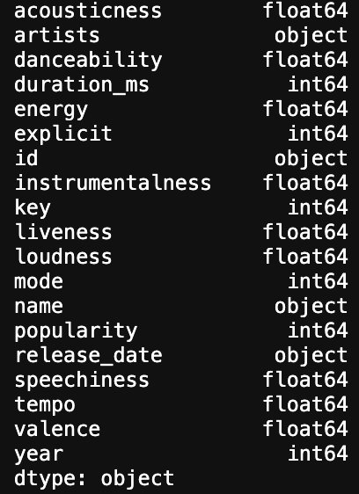
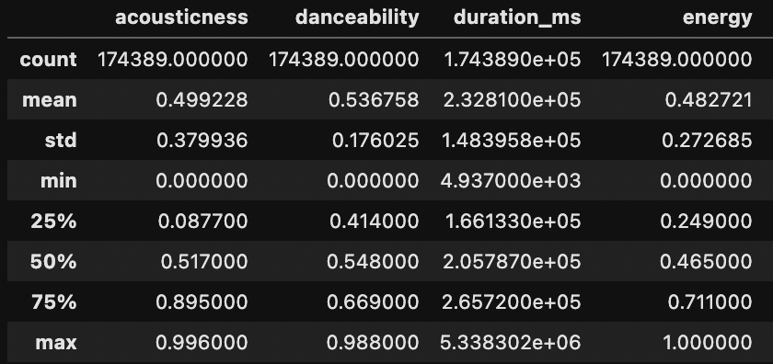
DATA CLEANUP
Explore Parameters
Choose Sample Size
Dataframe Cleanup
Save to CSV
Notes:
Insights from exploration:
understanding each parameter - Spotify API documentation
3000+ genres with unclean labels
trends of music attributes grouped by year - not too telling as it doesn’t say much about popularity
reduce sample size to most popular tracks only and look at music attribute trends (trend over year and correlation against popularity)
Cleanup:
readability - change duration to minutes instead of ms
convert objects to floats - we want to look at average values per year which cannot be done for object data types
rename column headers based on cleanup
drop any columns that are not needed
once clean, output to separate csv to do analysis

Slide 5
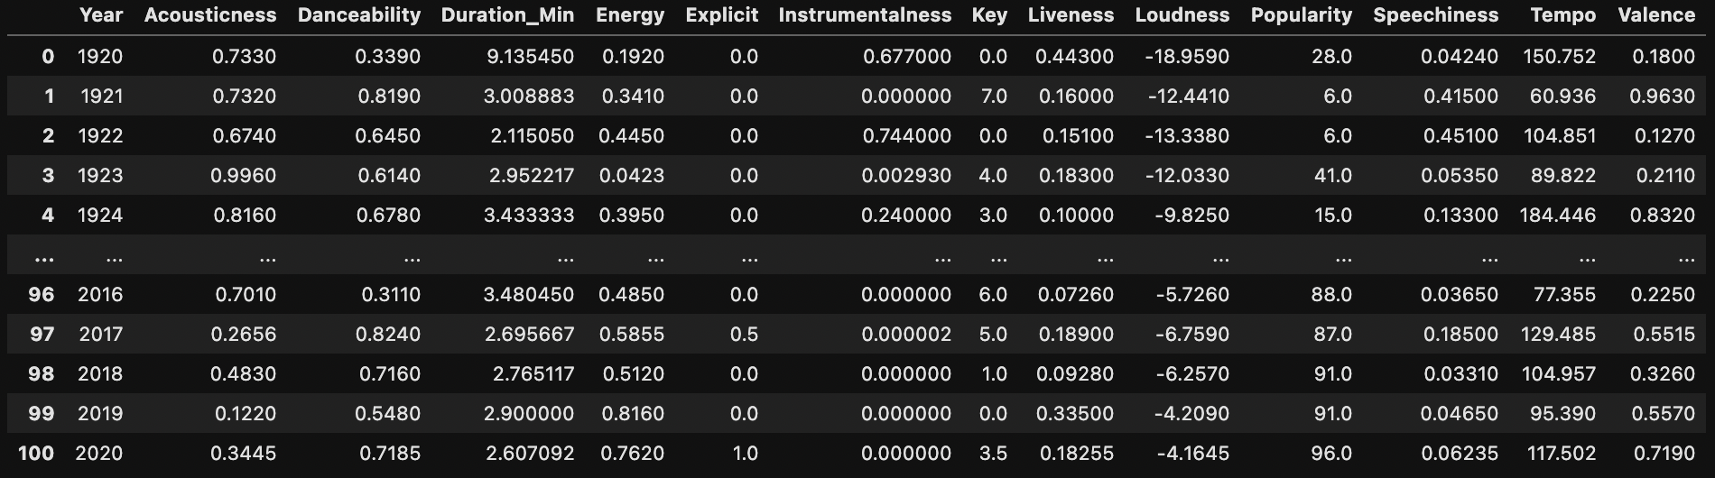
CLEAN DATAFRAME

Slide 6
DATA ANALYSIS
Tempo
Accousticness
Danceability
Notes:
##Tempo
The tempo of popular songs has primarily increased as time has gone one. This is almost certainly due to the invention and subsequent success of popular genres (in their more or less respective order of invention) Rock, Dance (which evolved from Disco when it absorbed some of the more muscular qualities of rock music) and Hip-Hop. Often made to be played loud in public spaces (concerts, clubs, shopping malls, etc..) these genres rely on beats, rhythms and vocals to fill in the empty spaces. Today’s most popular songs are very often the ones that keep going and keep listeners moving as well.
​
##Acousticness
The similarity between the graphs for both most popular and least popular songs by Acousticness speaks towards the decrease in popularity of acoustic instrumentation in contemporary popular music. A far-cry from the audience that sparked a now legendary near-riot when Dylan went electric in 1965 at the Newport Folk Festival, today’s listeners show a clear preference towards songs with electric/electronic instrumentation. Acoustic vs electric/electronic is now more of a matter of choice for musicians, and the meaning of sounds has thus changed over time. To most contemporary listeners, acoustic instrumentation often sets the expectation that a song or album will be of the more introspective singer/songwriter variety (think John Mayer or Sufjan Stevens) and very likely “sad”. With this in mind, it should not come to a surprise that listeners looking to lift their spirits during the Pandemic seem to have been drawn more towards less Acoustic music.
​
##Danceability
This is one that has stayed varied consistently over time, with less extreme popularity swings as we near the present day. One of primary reason’s for pop music’s existence has always been to get bodies to the dance floor, so it makes sense that this is a reliable variant. The sudden increase towards 2020 is somewhat surprising at first glance given international lockdown measures, but less so when one considers that many socially distanced listeners are/were very likely trying to make themselves feel as if are still at “the party” in some capacity.

Slide 7
DATA ANALYSIS
Duration
Energy
Explicitness
Notes:
##Duration
Like Danceability, this one has held steady over time. What was once dictated by a track’s ability to fit on a record or play on the radio between ad breaks has been solidified by the average listener’s attention span as well. It’s not unheard of for longer suite-style rock songs (*Bohemian Rhapsody* will never die) or extended dance remixes to find success, but the three-to-five minute pop song is virtually as old as the Music Industry and is not going anywhere.
​
##Energy
Popular music has become more energetic as time has gone on. This increase very likely has more to do with the capabilities and innovation of modern instruments. Electric and electronic instrumentation have allowed artists to exponentially increase the energy, and listeners and dance floors have been eager to keep up.
​
##Explicitness
The popularity of explicit songs has increased over time as well. They used to be basically non-existent, but cultural standards (particularly around the late ‘60s) began to loosen in relation to what was allowed on disc. Where making a song that couldn’t be played on the radio was once a deal-breaker for many artists, the largely streaming-based nature of most music (and the perpetually near-impossible nature of actually getting a song on the radio) now makes the decision of how explicit a song should be less relevant to many artists. This gives them significantly more freedom.
​
And most listeners do not seem put off by the explicit nature of popular songs. Just like popular cable shows like *The Sopranos* and *Game of Thrones* offer viewers with “premium” content often more explicit than what they can see in movie theaters, occasional explicit words or themes can remind listeners that they are getting their money’s worth over the same handful of “clean edits” that make their way into popular radio rotation.

Slide 8
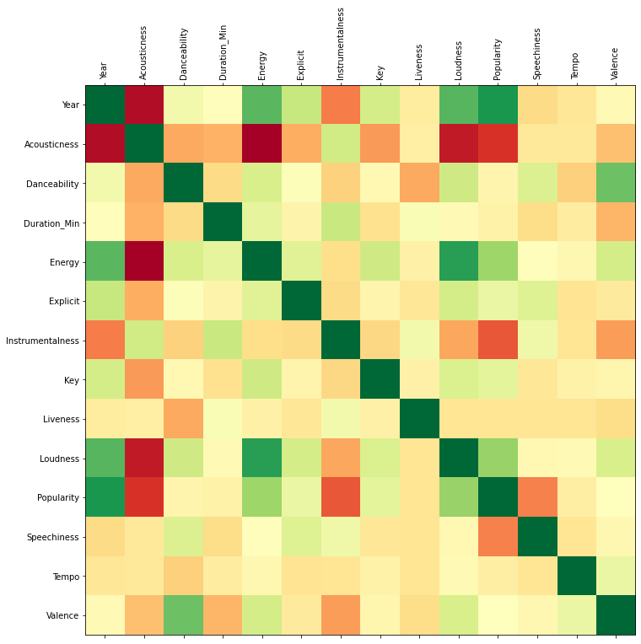
STATISTICAL ANALYSIS

Slide 9
DISCUSSION

Slide 10
POST MORTEM
Problem solving along the way
Expanded research possibilities
Notes:
Problem solving along the way:
Our approach was to split up the work load and really dive into the material individually that they had chosen or been assigned.
When people got stuck we were able to come together as a team and look through to see if we needed to adjust code, attack the data in a different way, or change the question being asked to something plausible
By approaching problems this way we were able to leverage all of our strengths into a cohesive unit and kept progress moving
Expanded research possibilities
Taking the time periods leading up to and immediately following major world events to see how music was altered
Or doing the same thing but with specific influential artists ie.- beatles, NWA, Elvis,
Take our approach from a decade by decade approach
Assign value ranges for genres to consolidate the genre list that is present in this dataset

Slide 11
Q&A

